Slide 1
YOUR GUIDE TO
Lytho
Questions? Contact the Communications team at creativesolutions@connerstrong.com.

Slide 2
Agenda
Introduction to Lytho
Platform Overview + Navigation
Making Requests
Your Reviews
Final Files

Slide 3
Welcome to Lytho!
Lytho is a versatile platform purposely designed to empower teams to achieve better outcomes through collaboration. From request intake to project management to reviewing proofs, Lytho will help us align, manage, and assess all aspects of our communications deliverables.
Lytho will go live on Monday, May 10, 2021, at which point you will no longer have access to the classic inMotion platform. No new projects may be submitted after 12PM on Friday, May 7, 2021 as we transition over to the new platform.

Slide 4
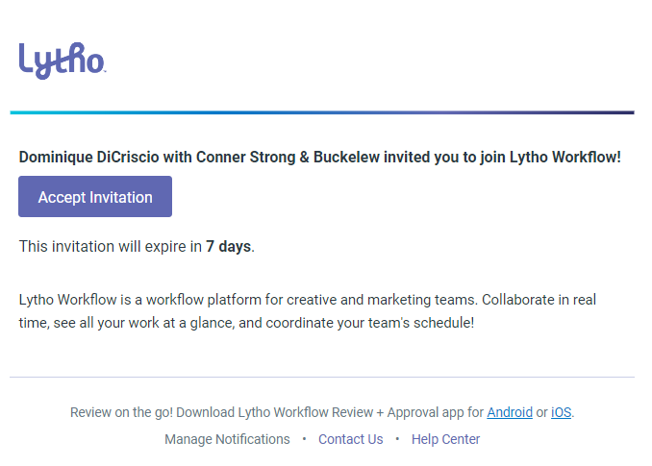
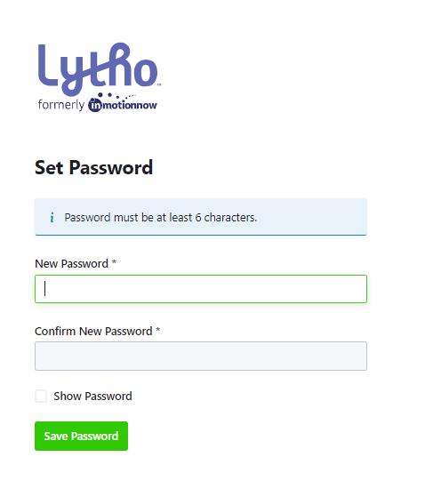
Creating Your Account
By Monday, May 10th, you will receive an email from welcome@inmotionnow.com. Invites expire in seven days. If your invite expires, contact creativesolutions@connerstrong.com.
Accept invitation immediately
Create your account by setting a password
Bookmark our unique Lytho ignite URL: connerstrong.ignite.inmotionnow.com
1
2
If you have trouble logging in, check out these Login FAQs.

Slide 5
OVERVIEW +
Navigation

Slide 6
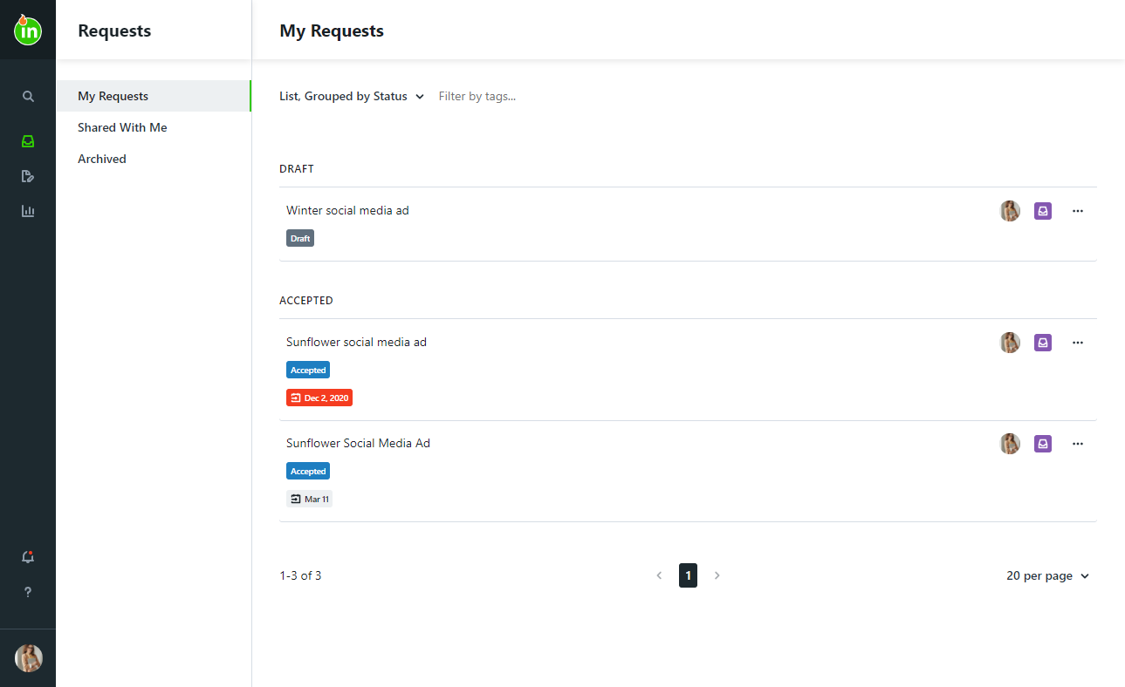
Navigating through Lytho
You will see My Requests when you first log in.
Global Search
Create & Monitor Requests
Complete Reviews
See Shared Reports
Notifications
Personal Settings

Slide 7
MAKING
Requests

Slide 8
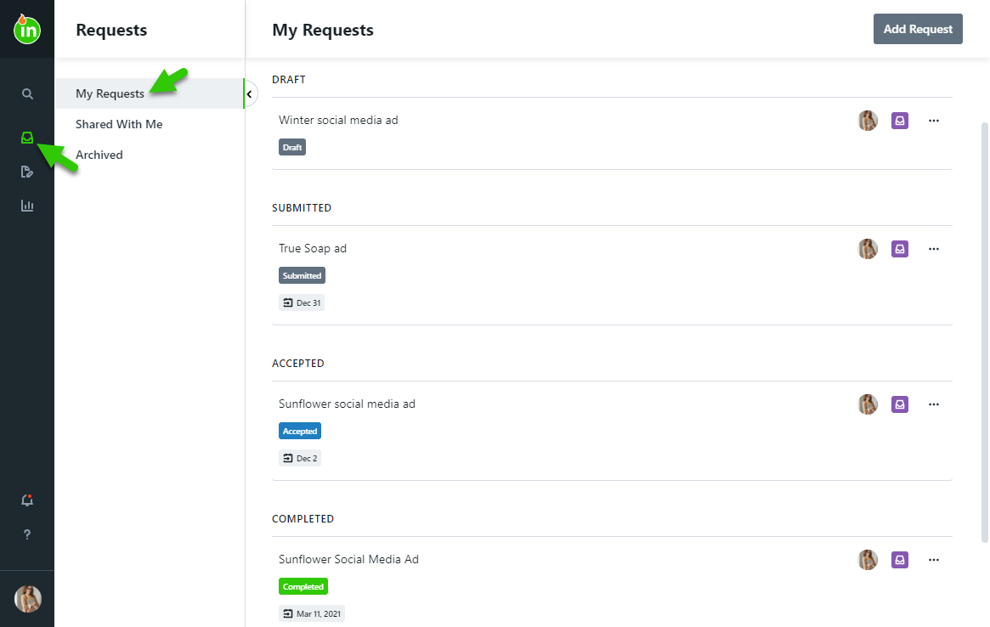
Requests Workspace
Create a New Request
For more information about requests, click here.
Requests progress through the following statuses:
Draft: Still in progress; not yet submitted by the requester
Submitted: Acceptors are notified of the new request for review
Accepted: Acceptors have approved the request and created work to fulfill the request
Completed: Work is complete & the requester is notified
Archived: Work has been archived for future reference

Slide 9
Creating a Request
Navigate to the Requests tab
Select Add Request
Name your request (Client Name + Description)
Select the best form for your request needs
Fill out the form in detail — inputs are saved automatically!
Submit the request

Slide 10
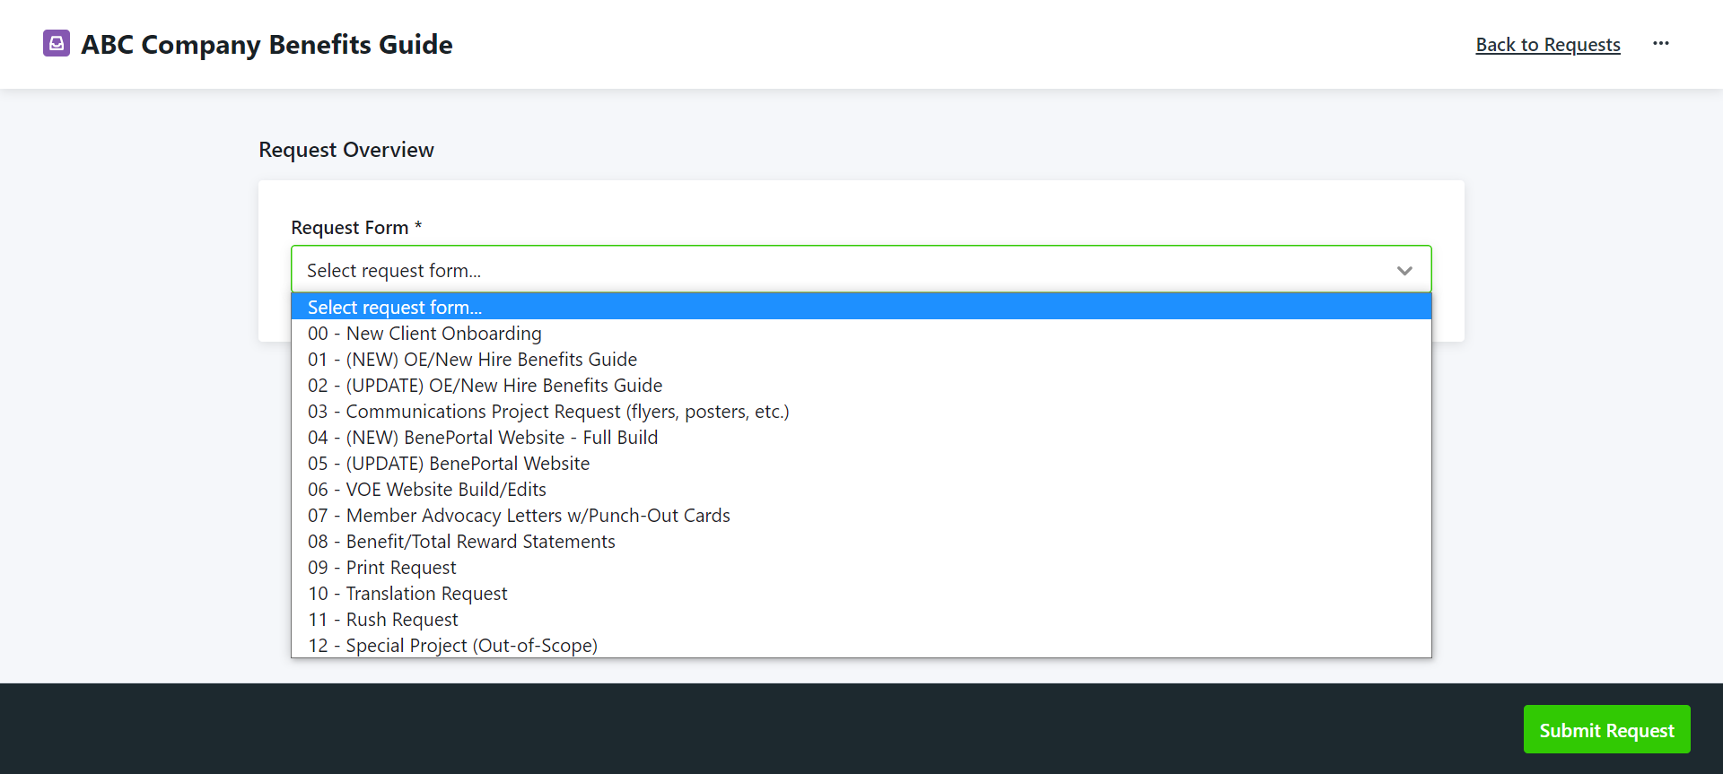
Request Forms
Here is where you will select the type of communication you need using our custom request forms. Each form includes important information at the top of the screen, such as turnaround times.
NOTE: Due dates are restricted by standard turnaround times.

Slide 11
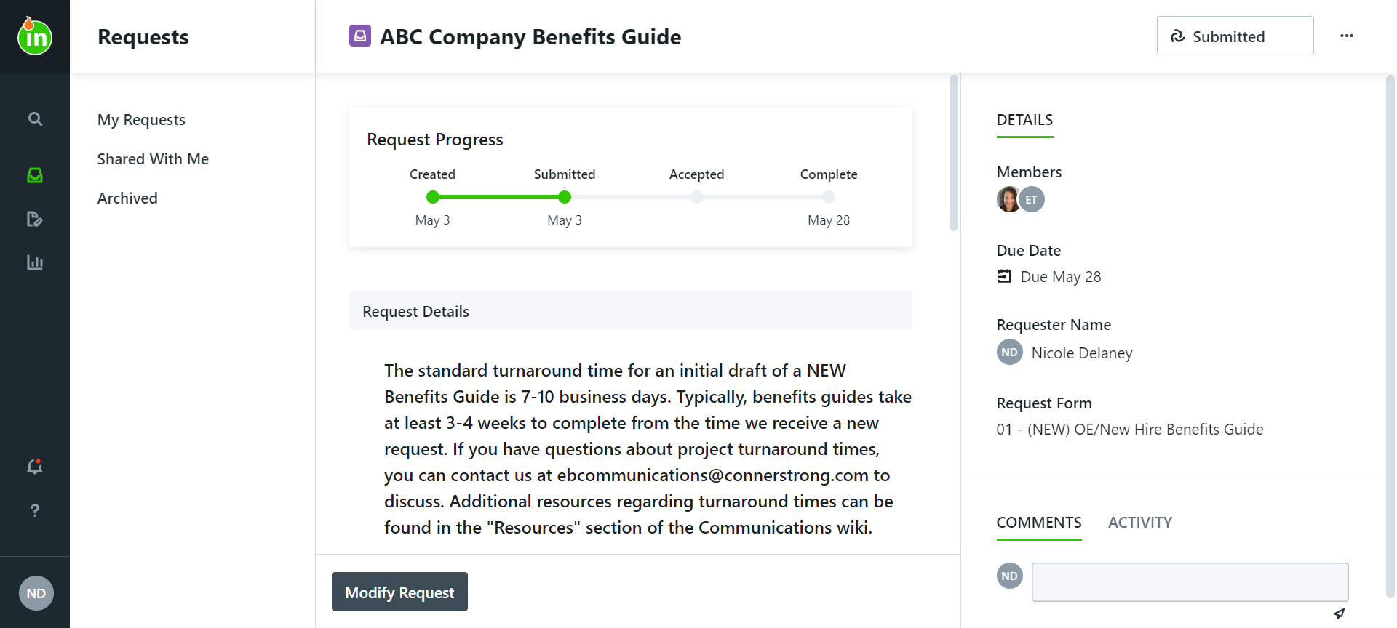
Updating + Sharing the Request
Before the request is accepted, you can modify it and/or communicate with the Communications Team. Once accepted it can no longer be modified.
Share your requests so that your submission and assets can be shared with others.
Duplicate requests to reduce repetitive work.
Export the request as needed to view outside of ignite in a PDF format.

Slide 12
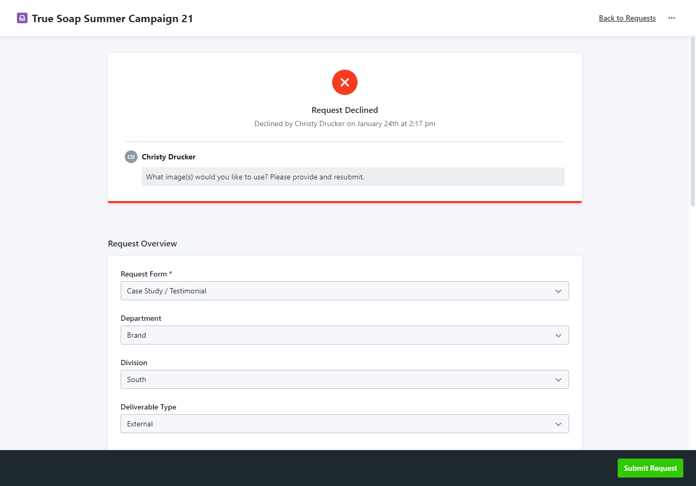
Resubmitting a Declined Request
ABC Company Benefits Guide
If your request is declined, you will receive a notification that includes a message explaining why the request was declined
Your request will return to Draft status
Provide the needed information and then you can resubmit

Slide 13
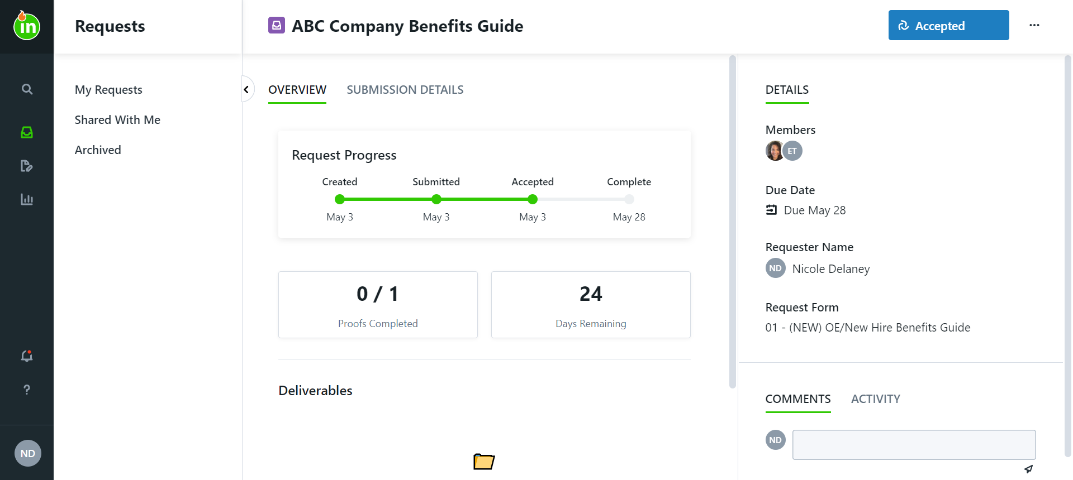
Monitoring Request Progress
You will be notified when:
The request is accepted
The request is completed
Any changes are made to the request due date
You are @mentioned or replied to in a comment
The original request can be viewed in the Submission Details tab. As work begins, you will see:
Progress of associated work- this indicator will appear in red if work is overdue
Proofs completed
The number of business days remaining
All files shared as Deliverables

Slide 14
YOUR
Reviews

Slide 15
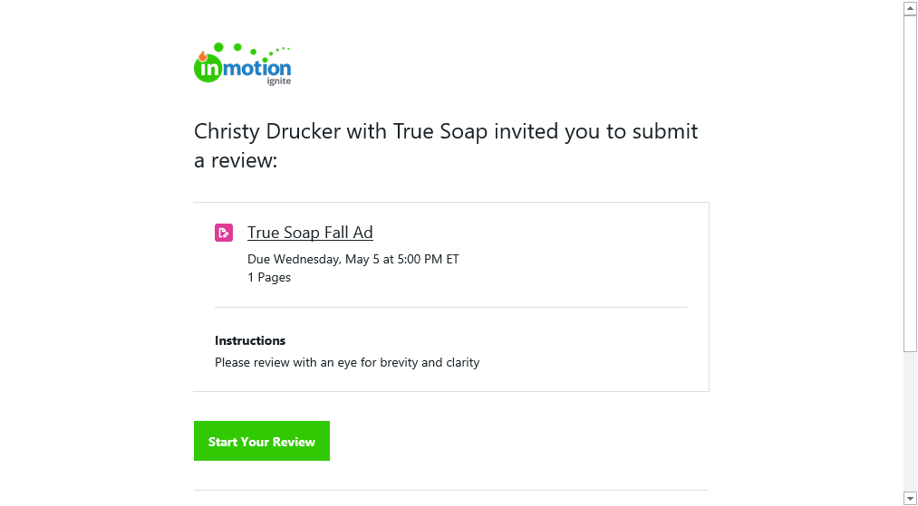
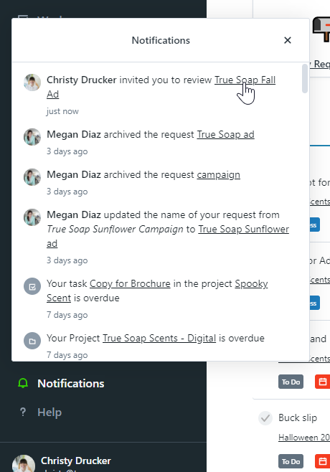
Receiving Your Invite to Review a Proof
You will receive an email from noreply@inmotionnow.com including the:
Review Name
Review Deadline
Review Instructions
Number of Pages
Associated Project Name & Due Date
Click Start Your Review to access the review

Slide 16
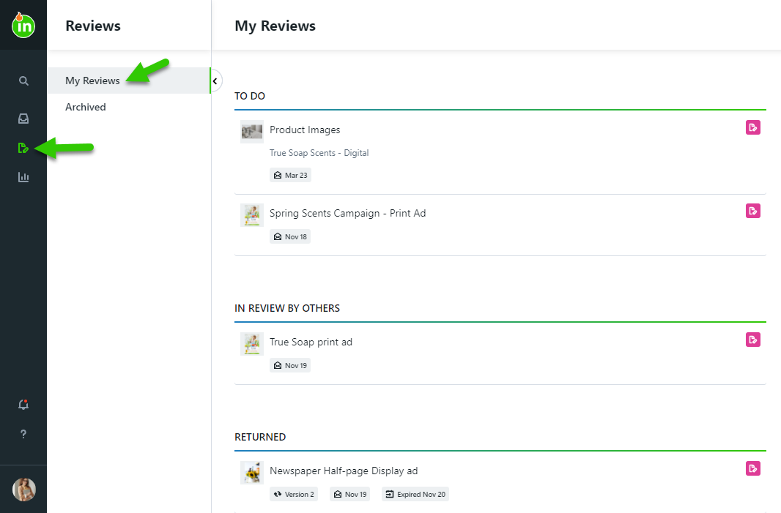
Reviewing a Proof
Find reviews awaiting your approval on your Dashboard or within the My Reviews tab. Reviews will progress through the following statuses:
To Do: Your approval needs to be provided
In Review By Others: You have completed your review, but the proof is still pending the review of others
Returned: Reviews that have ended
Archived: Reviews that have been archived for future reference

Slide 17
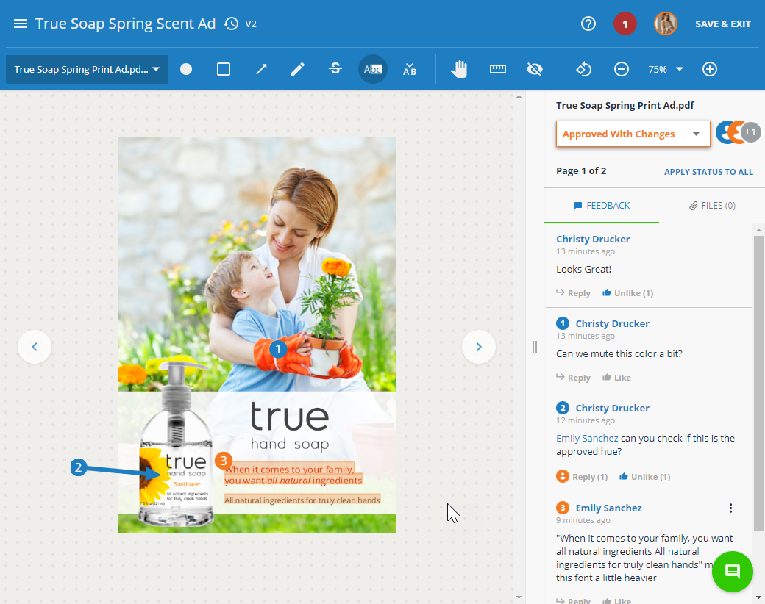
Provide Feedback
Provide feedback by marking up the assets using the intuitive annotation tools in the toolbar.
Each annotation will automatically be numbered and associated with a comment
Use the page navigation menu or the arrows next to the asset to navigate through review pages
@mention other reviewers, like other comments, and attach files to comments
You can also share the review with others not invited via @mentioning or the share menu
Review Tools
For more information about review tools, click here.

Slide 18
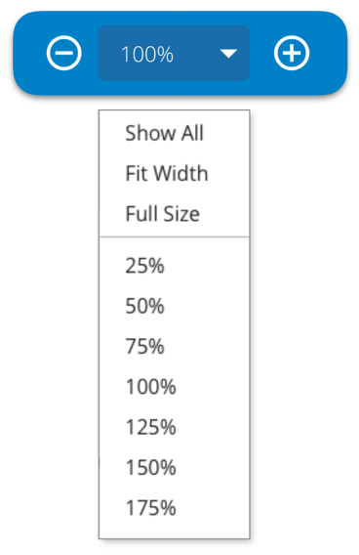
Reviewing Tips + Tricks
Use the Zoom Tool instead of your browser zoom.
You have options to ‘Show All,’ ‘Fit Width,’ and see ‘Full Size’
The max level may vary based on the asset size and your choice of browser
Assets default to “Show All,” which allows the reviewer to see the full length and width of the asset
Your browser’s built-in spell checker will automatically underline any misspelled words in your comments
Text markup tools are only available if text can be identified in the asset. This includes common file formats like .pdf or .doc
If the asset being reviewed includes text, use Ctrl+F to search for a word or phrase

Slide 19
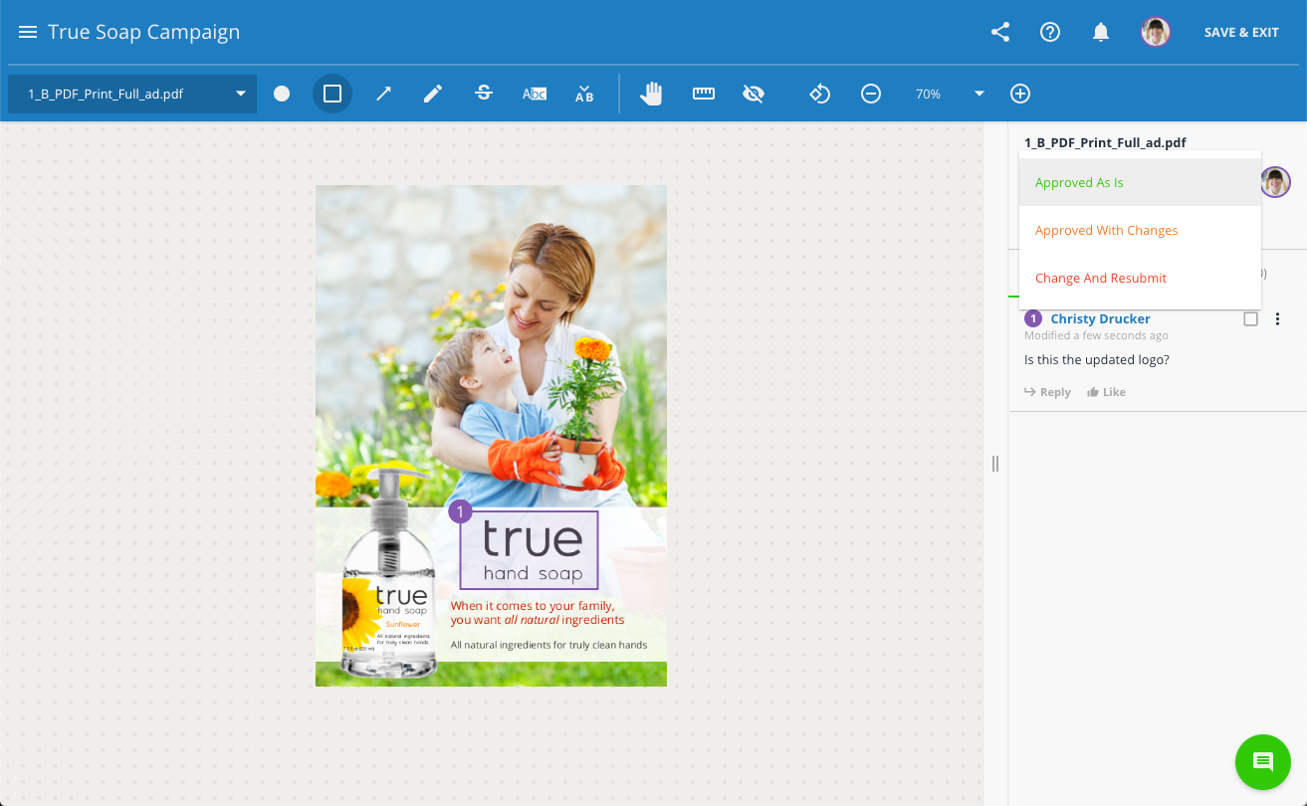
Select Approval Status + Submit
You must select an approval status for each page, or you can apply one approval status to all pages
Approved As Is: If you require no changes
Approved With Changes: If at least one change is required but you do not need to see another version for it is finalized
Change & Resubmit: If you need to see another version before the asset is finalized
When approved statuses have been selected for all pages, you must submit your review!

Slide 20
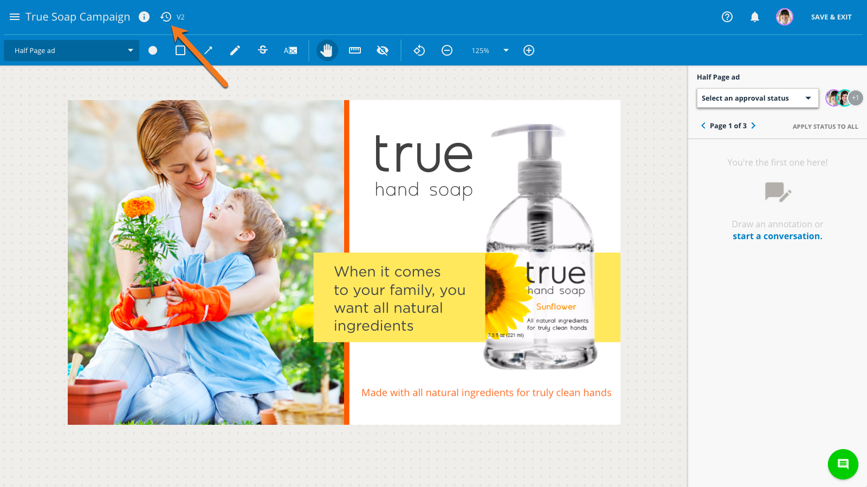
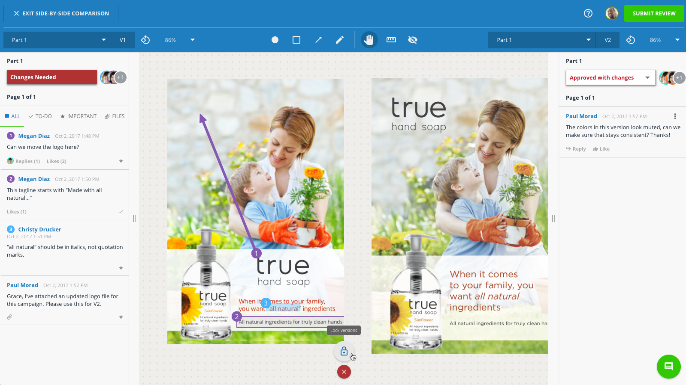
Review Past Versions Side-by-Side
If the proof is versioned, you can also access previous versions by selecting the versioning icon located to the right of the review name.
The proof’s version history will open to the left.
Hover over the version you’d like to reference to open it in either side-by-side comparison or a new tab of your browser
When in side-by-side mode, click the lock icon near the bottom center of the screen to pan, zoom, rotate, and navigate through both versions in tandem
You will not be able to comment on past versions – only the active version

Slide 21
FINAL
Files

Slide 22
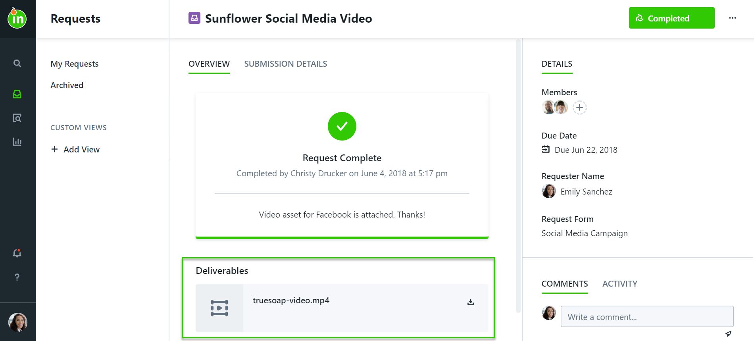
Final Files + Request Completion
You will be notified when the request is complete
Access & download all provided final files in the Deliverables section of the request
These files will remain in Lytho so you will always have access to them
Archived requests will remain available in the Archived section of your Requests tab
If you have trouble finding a completed request, don’t forget to use Global Search!

Slide 23
Thank you!
connerstrong.ignite.inmotionnow.com

